Slide 1
A Fresh Look at
Visual Studio for Mac
Amanda Silver
CVP of Product for Microsoft’s Developer Division
Scott Hunter
Partner Director PM, Visual Studio and .NET

Slide 2
Increasingly complex developer landscape
Broad expertise required
Spanning back-end and multiple front-ends
Multiple development technologies & languages
Machine Learning & AI becoming more embedded in any solution
Modern app development
Containers, microservices, serverless
Multiple experiences as end-points (devices, bots, etc.)
Notes:
Over the past few years, we’ve seen increasing speed at which new technologies emerge each of which comes with domain specific frameworks, tools, and services.
While this enables developers to build anything they want, it also translates into an increase in complexity and less time to learn each technology deeply.
Developers are expected to become polyglots, spanning back-end and front-end / client development. This often means they need work in multiple programming languages and a diverse set of frameworks. Most recently, more solutions are expected to integrate artificial intelligence adding further complexity as developers attempt to master Machine Learning.
Furthermore, modern app development requires knowledge of a variety of deployment mechanisms. Whether its containers, microservices, or serverless architecture (or all of them), developers have to design for multiple user experiences as application end-points, be that mobile, IoT, or other devices, chat bots, augmented reality, and more.

Slide 3
Best-in-class tools and services
for any developer,
any app, any platform
DEVELOPER TOOLS
Visual Studio for Mac
Visual Studio
Visual Studio Code
DEVELOPER SERVICES
GitHub
Azure DevOps
Visual Studio App Center
CLOUD PLATFORM
Azure
Notes:
With Visual Studio, our mission is to empower developers and accelerate development teams.
Today, the Visual Studio name stands for SO much more than it ever has before.
The core of our vision is to provide “best-in-class tools and services for any developer, building any app, for and on any platform”, so over the past few years in particular, we have really expanded the product family quite a bit to match that vision.
Now we have:
A cockpit style IDE for both PC and Mac dev machines
Which enables developers to develop any app and target any platform they wish (Mobile, Cloud, Web, Desktop, IoT)
Visual Studio Code as our cross-platform, lightweight code editor.
And developer services like GitHub, Azure DevOps, and Visual Studio App Center to complement the IDEs & editors to complete the full application lifecycle.
Whether you’re developing for Windows, Mac or Linux, Android or iOS, all of these developer tools make Azure just sing.
Today we’re focusing on Visual Studio for Mac which we’ve put a lot of energy into.
Visual Studio for Mac is for C# developers who feel at home in the Mac OS.
If you’ve checked it out before – we think it’s time to take another look.

Slide 4
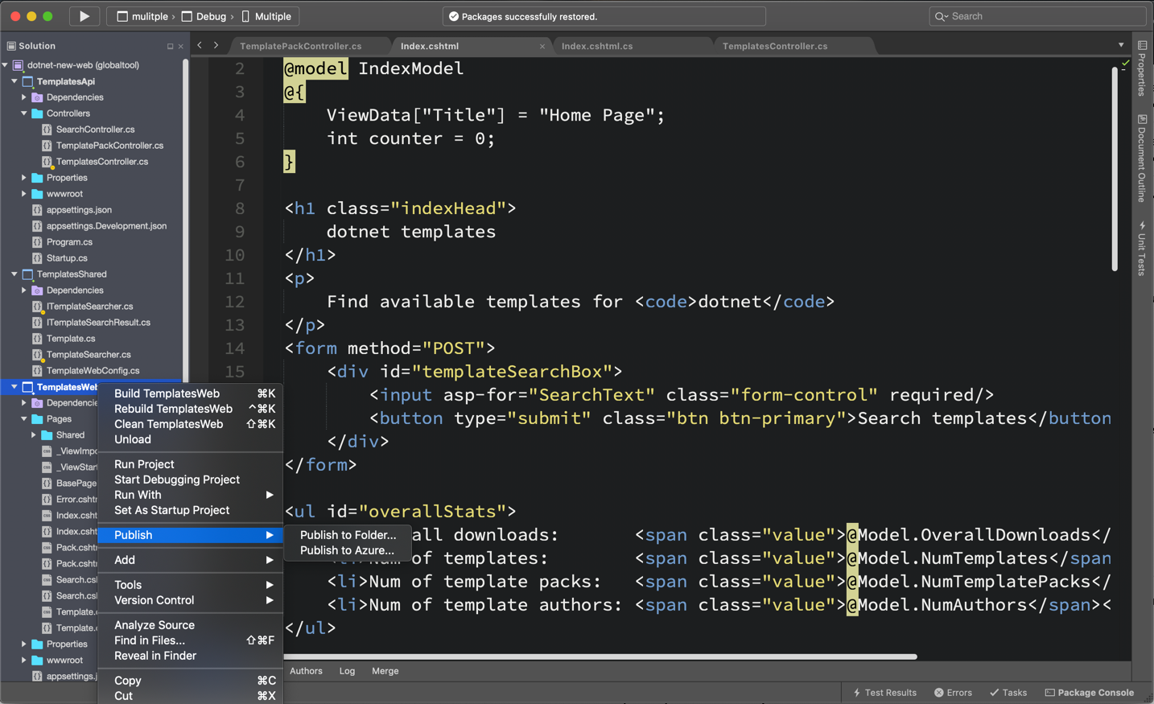
A powerful Mac IDE
Write better, more consistent code, faster
Advanced refactoring capabilities for better code
One-click code clean-up to apply multiple refactoring rules
Be a team player with .EditorConfig integration
Spend less time on menial tasks
Be more productive with built-in IntelliSense for .NET
Syntax highlighting to help you focus on what really matters
Test your code with support for xUnit, MSTest, NUnit
Teams benefit from integrated Git source control
Designed and Optimized for Mac
Feel right at home with a native Cocoa UI
Integration with macOS assistive technology tools
Notes:
Over the past year, we’ve focused on helping developers write better code, faster.
We know it’s critically important that developers keep their focus on the code. We’ve removed distractions in the UI making the user experience more streamlined.
For example, when you launch Visual Studio 2019 for Mac, you’ll be presented with a new start window, which is optimized to get you to your code faster.
Developers will also find a new search experience in Visual Studio 2019 Mac, enabling them to find everything from a single place.
The goal with these improvements is to reduce the amount of context switching you have to do, so you can stay in the zone.
Cleaning up and refactoring code is better than ever to help you comply with the coding standards that have been set by the team.
We want you to spend less time on the tedious, menial, and repetitive and more time thinking about the code that’s unique to your solution.
We have integrated Git and have designed the IDE to feel native to the Cocoa UI with integration for the macOS assistive tech.

Slide 5
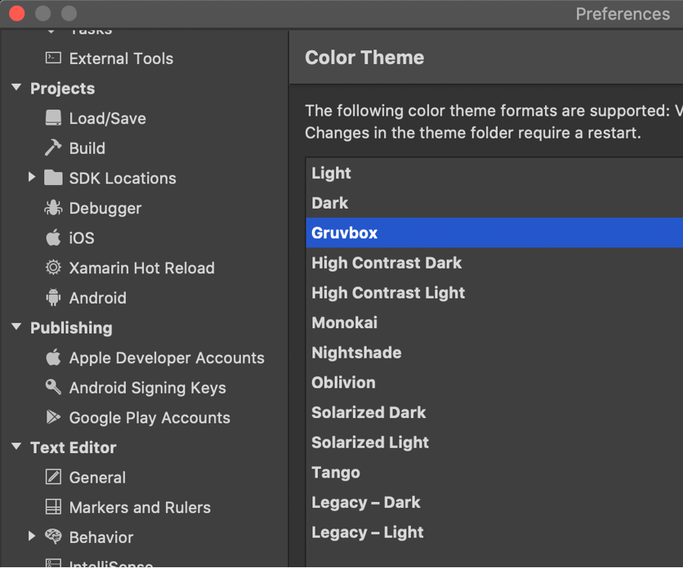
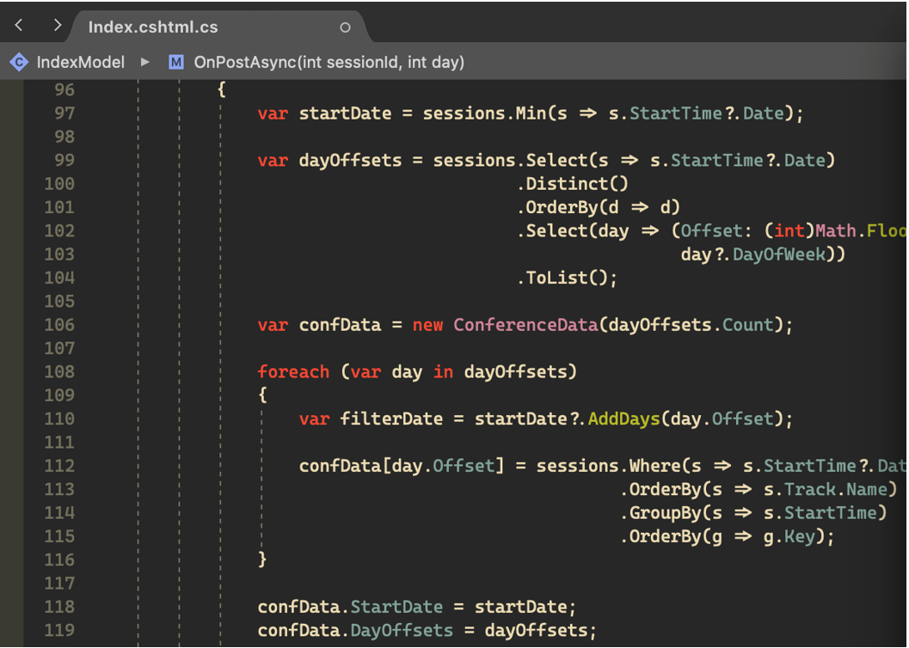
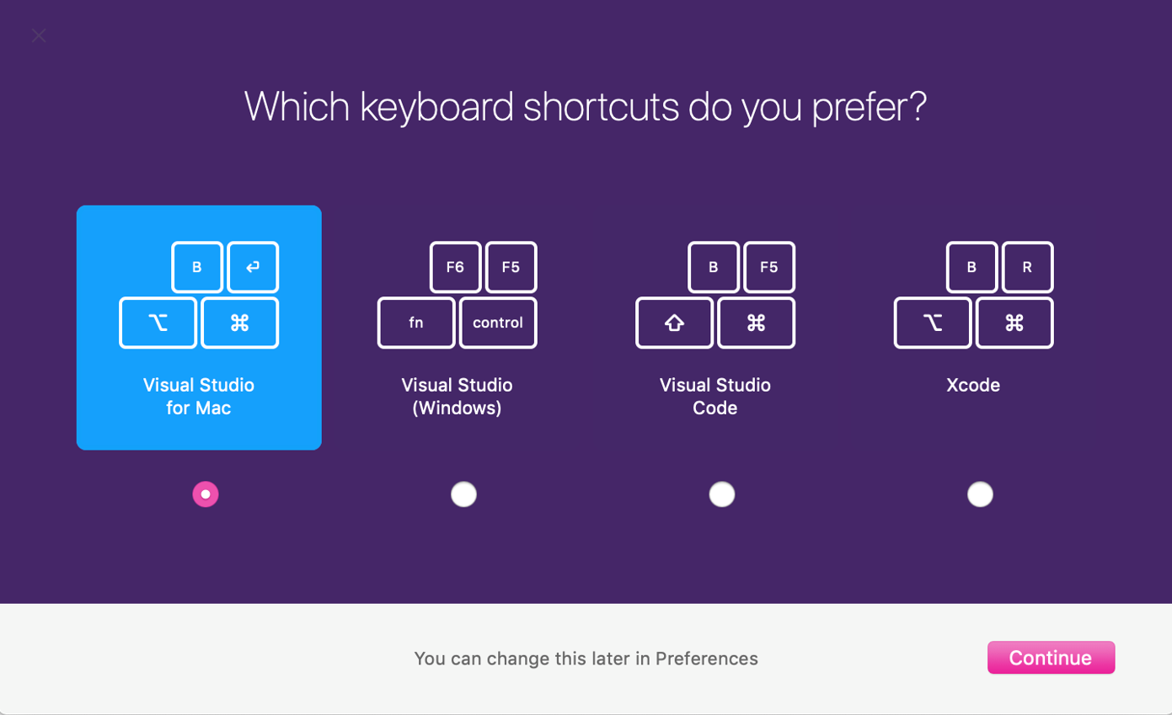
Make it yours
Custom themes to make you feel at home
Choose default or customizable keyboard shortcuts
Full support for custom fonts and ligatures
Keychain integration for signing in to Azure
Integrate custom tools
Notes:
But you should absolutely customize it so it’s tuned for your optimal productivity.
You can integrate custom themes so you feel at home with your own key bindings and full support for custom fonts and ligatures.

Slide 6
Visual Studio for Mac v8.1
June 2019
8.1
July 2019
8.2
Sep 2019
8.3
Jan 2020
8.4
Mar 2020
8.5
May 2020
8.6
New macOS Native C# Editor
Notes:
And with your feedback, we’re continuously improving the product.
With 8.1, we introduced a new macOS native C# editor so it has support for word wrapping, the best Intellisense experience yet, glyphs and more.

Slide 7
Visual Studio for Mac v8.2
June 2019
8.1
July 2019
8.2
Sep 2019
8.3
Jan 2020
8.4
Mar 2020
8.5
May 2020
8.6
Startup performance (up to 50%)
C# editor enhancements
Notes:
With 8.2, we continued to improve the editor and improved startup performance significantly.

Slide 8
Visual Studio for Mac v8.3
June 2019
8.1
July 2019
8.2
Sep 2019
8.3
Jan 2020
8.4
Mar 2020
8.5
May 2020
8.6
.NET Core 3.0 SDK
C# 8 support
Debugger reliability and performance
Notes:
With 8.3, we introduced support for .NET Core 3.0 and C# 8 – ensuring that you have great compatibility with your colleagues on VS for Windows.
We also improved debugger reliability and performance.

Slide 9
Visual Studio for Mac v8.4
June 2019
8.1
July 2019
8.2
Sep 2019
8.3
Jan 2020
8.4
Mar 2020
8.5
May 2020
8.6
.NET Core 3.1 support
Server-side Blazor
.razor support
ASP.NET Core Templates with Authentication
ASP.NET Core Scaffolding
Worker Service Template,
XAML Hot Reload for Xamarin
Notes:
8.4 was a big release
- .NET Core 3.1
- Server-side Blazor support
- Support for .razor files
- ASP.NET Core templates with support for Authentication out the box
- And we continually work on improving the developer inner loop with XAML Hot Reload for Xamarin

Slide 10
Visual Studio for Mac v8.5
June 2019
8.1
July 2019
8.2
Sep 2019
8.3
Jan 2020
8.4
Mar 2020
8.5
May 2020
8.6
Azure Functions v3
SPA Templates with Authentication
Notes:
In 8.5 we added support for Azure Functions v3 as well as SPA templates with Authentication.

Slide 11
Visual Studio for Mac v8.6
June 2019
8.1
July 2019
8.2
Sep 2019
8.3
Jan 2020
8.4
Mar 2020
8.5
May 2020
8.6
Blazor WebAssembly
gRPC support
Integrated Terminal
https://docs.microsoft.com/en-us/visualstudio/productinfo/mac-roadmap
Notes:
And coming in May – with our 8.6 release, we’ll introduce support for Blazor WebAssembly, gRPC which is popular for microservices architectures, and support for an Integrated Terminal – so even less context switching.

Slide 12
Performance and Reliability Improvements
200% increase in Context Menu responsiveness
Cut hangs by 50%
Reduced unhealthy sessions by 25%
Increased IntelliSense performance by 400%
Notes:
These stats show performance and reliability improvements when compared to Visual Studio 2017 for Mac
Overall these releases, we’ve continually improved the performance and reliability of the product.
- We’ve cut hangs by 50%
- Have a 200% improvement in the responsiveness of context menus
- Reduced unhealthy sessions by 25%
- And we’ve improved IntelliSense performance by 400%

Slide 13
Why Visual Studio for Mac?
Better Performance and Battery Life than a VM
Native MacOS look and feel
Better Integration with MacOS
Full IDE experience
Optimized for .NET core workloads
Notes:
So why Visual Studio for Mac?
It’s the best C# / ASP.NET editor native to the MacOS.
- You get better battery life
- A native MacOS look and feel
- Better integration with MacOS accessibility
- The full IDE experience
- And it’s optimized for .NET core workloads

Slide 14
Customer Story: Ernst & Young
Aaron LaBeau
EY Client Technology | Mobile Technologies Tech Lead

Slide 15
.NET on Mac
Scott Hunter
Partner Director PM, Visual Studio and .NET

Slide 16


.NET
Your platform for building anything
Desktop
Web
Cloud
Mobile
Gaming
IoT
AI
Notes:
You can build anything with .NET.
We’ve made significant investments in .NET over the years as well as unifying the ecosystem to support building literally anything. From desktop to gaming to the cloud, .NET is a general purpose programming platform that enables all kinds of application scenarios. Once you learn one, you can easily pick up another.

Slide 17




.NET ecosystem momentum Transforming .NET from Closed Source & Windows-only to Open Source & Cross-platform
>1M .NET Core developers
#1 Most Loved
Framework
Top 30
Highest velocity OSS projects
.NET Core
github.com/dotnet github.com/aspnet
in Visual Studio
Top 5
Language on GitHub
7x
Faster than Node.js
40%
New to .NET are students
C#
ASP.NET Core
dot.net download survey
Notes:
https://insights.stackoverflow.com/survey/2019#most-loved-dreaded-and-wanted
https://github.com/cncf/velocity/
https://octoverse.github.com/
https://www.techempower.com/benchmarks/#section=data-r18&hw=ph&test=plaintext

Slide 18























www.dot.net/customers
Notes:
Amazing developers like you have built incredible software with .NET for millions of companies around the world, in every industry. Here’s just a few. You can read their stories on our dot.net website.
<CLICK>
Customer notes (optional to call out here. Suggest keep it quick)
Setpoint Medical:
As a 35-person startup company, SetPoint Medical is a pioneer in bioelectronic medicine and has developed an implantable electronic therapy for treatment of chronic autoimmune diseases. This field has the potential to disrupt the pharma industry by eliminating drug treatments and side effects for these diseases. They build implantable medical devices used to treat the symptoms of a variety of autoimmune disorders, including Rheumatoid Arthritis, Chron’s Disease, and even Multiple Sclerosis.
They use WPF for their test infrastructure and applications. Moving to .NET Core 3.0 allowed them to take advantage of Windows 10 Bluetooth stack which dramatically simplified their application and helped them achieve regulatory compliance from the US government.
UPS: (everyone knows UPS)
UPS Mobile app—has improved customer experience and nearly halved the amount of code, compared with the previous platform-specific versions. Developers quickly brought the app to market using Visual Studio Tools for Xamarin.
Siemens Healthineers:
Siemens Healthineers is leading the digitalization of healthcare by helping health providers and solution developers bring more value to the delivery of care, ultimately improving the quality of insights derived from healthcare data. Siemens Healthineers uses Microsoft Azure to make solutions more accessible, and it uses Azure Kubernetes Service (AKS) and .NET Core for a fast, efficient, and competitive development pipeline.
Evolution Software:
Evolution Software Design, Inc. is a consulting firm that helps other organizations apply technology more effectively through strategic technology solutions and by developing healthcare, e-commerce, agriculture, and enterprise applications. One of the company's recent ventures is in the hazelnut industry, partnering with various hazelnut processing companies to improve the quality of hazelnuts from farm to consumer using machine learning and ML.NET. Evolution Software uses ML.NET to predict moisture levels of hazelnuts during the commercial drying process and alerts operators when they reach the ideal level.

Slide 19

Stack Overflow migrates to .NET Core 3.0 for better performance, faster development, and containerization.
Notes:
https://www.youtube.com/watch?v=1DIDWWKk8Bg

Slide 20




.NET – A unified platform
TOOLS
DESKTOP
WEB
CLOUD
MOBILE
GAMING
IoT
AI
VISUAL STUDIO
VISUAL STUDIO FOR MAC
.NET STANDARD
LIBRARIES
VISUAL STUDIO CODE
INFRASTRUCTURE
RUNTIME COMPONENTS
COMPILERS
LANGUAGES
CLI

Slide 21
Productive .NET developer experience
Build .NET Core apps
Full support for .NET Core 3.1
Advanced refactoring with Roslyn
Full NuGet package management support
Performant web apps and APIs with .NET Core
Create the next gen web apps with ASP.NET Blazor
ASP.NET Core is the best framework for the web
Lightweight websites Razor Pages
Be more productive with Scaffolding and templates

Slide 22
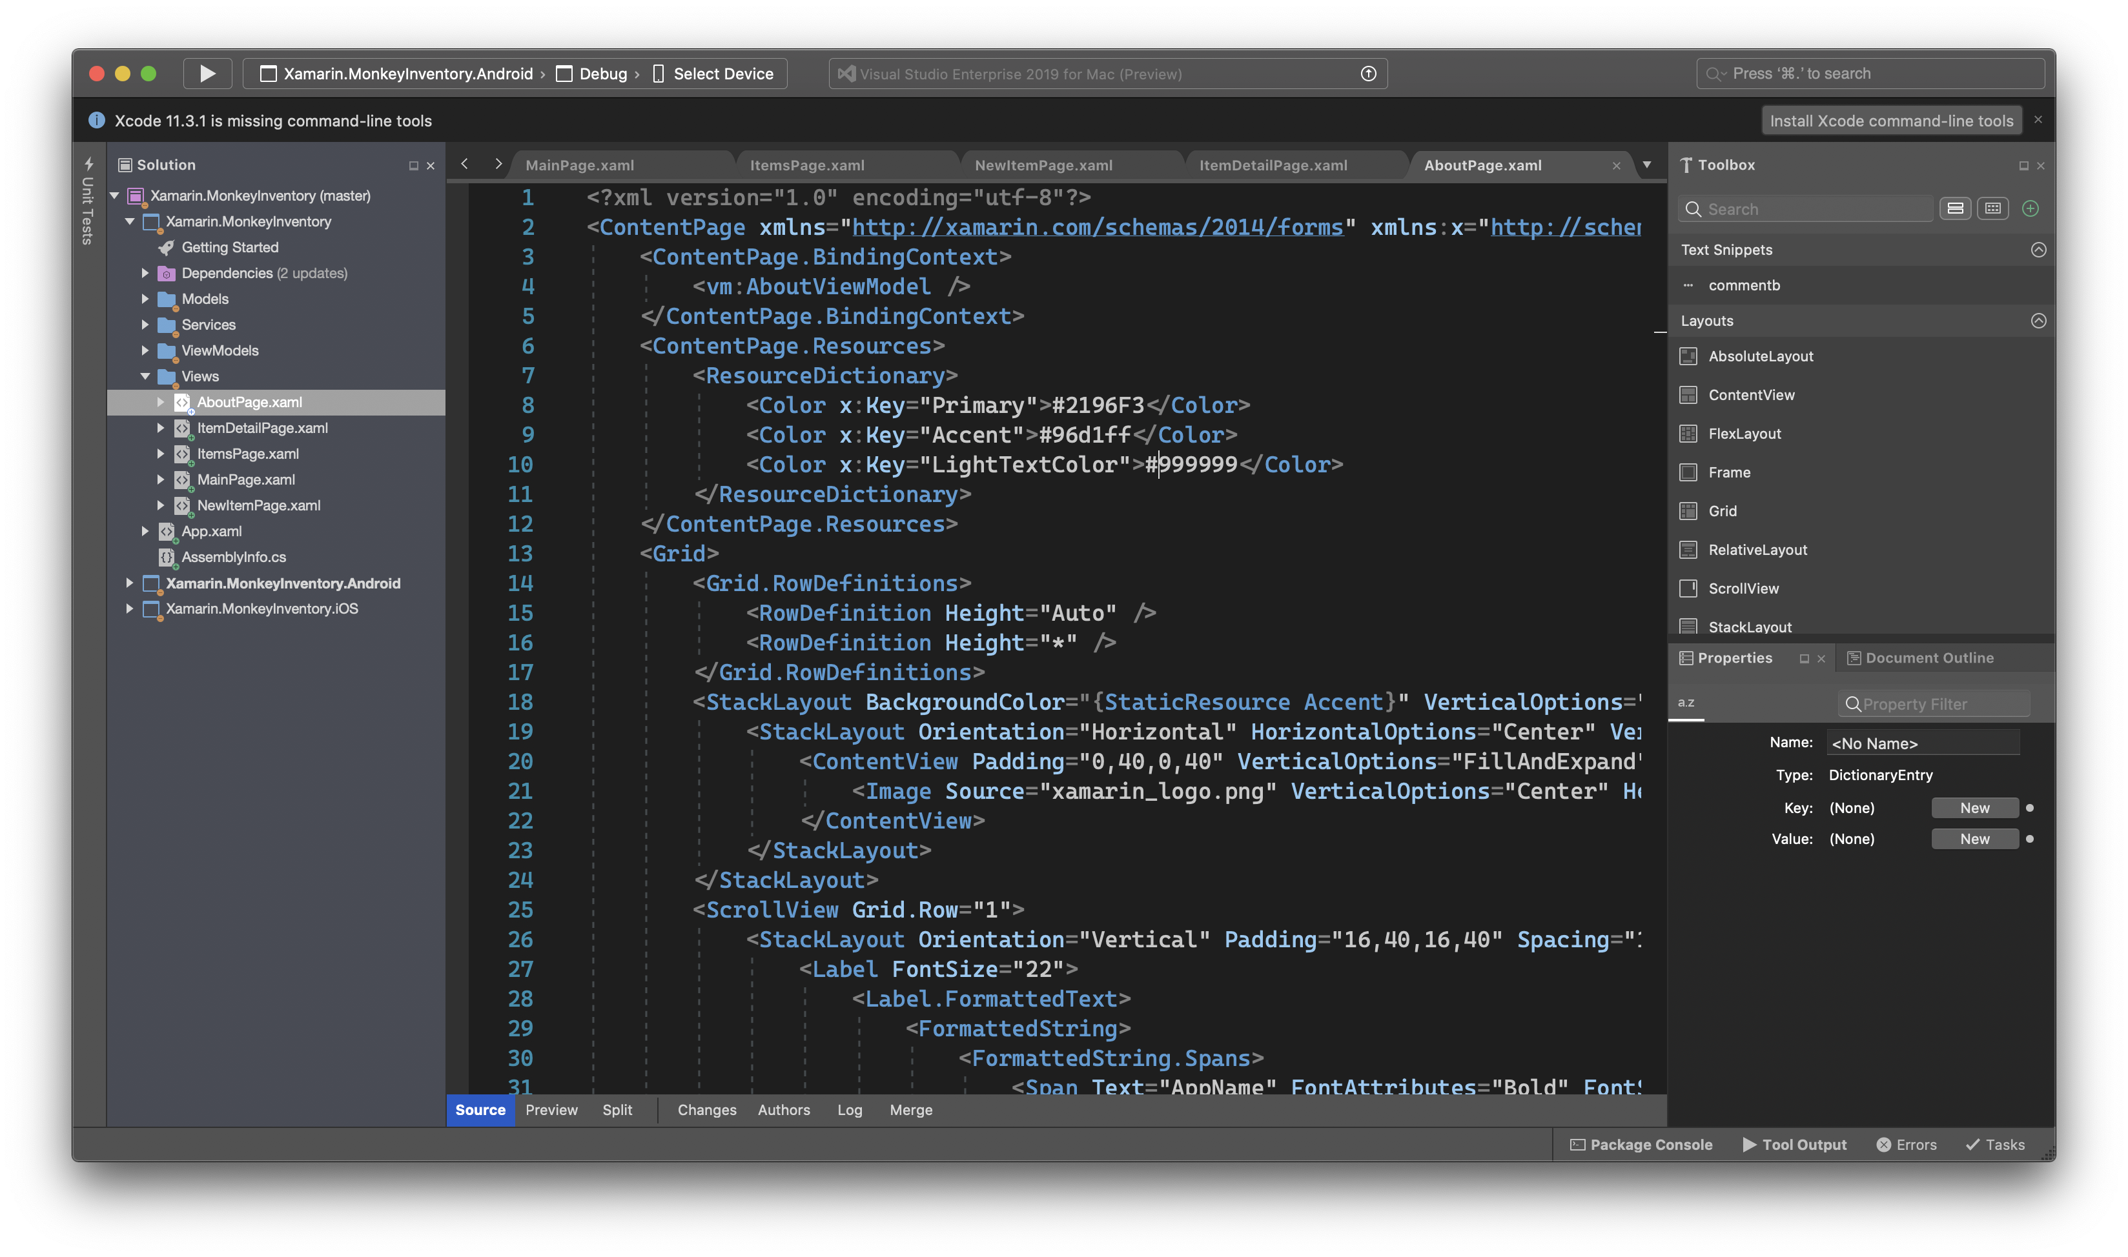
Cross platform, native apps with Xamarin
Build native mobile apps
Use .NET to build native iOS and Android apps
Built-in iOS provisioning tools
Multi-platform support - Android, iOS, WatchOS, macOS, tvOS
Productivity at your fingertips
Build great cross-platform apps with Xamarin.Forms
Faster development loop with XAML Hot Reload
Focus on the code that matters with XAML IntelliSense

Slide 23
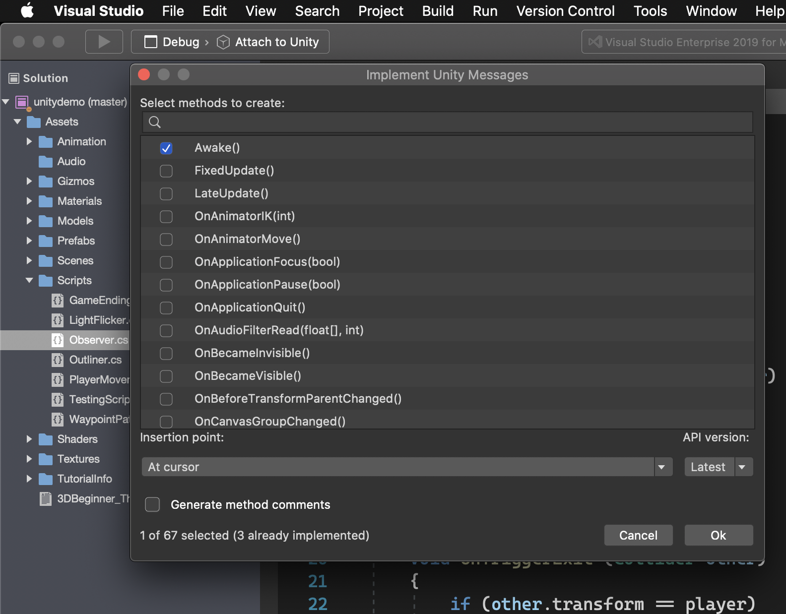
Game Development with Unity
Optimized for game developers
Code better with built-in IntelliSense for Unity messages
Fix issues faster with our advanced, Unity-optimized debugger
Code analysis with Roslyn diagnostics and quick-fixes for Unity
Fully open source analyzers
Create next gen games with Unity
Design immersive games and 2D/3D applications with Unity
Deep integration with Unity Editor for browsing and adding files

Slide 24
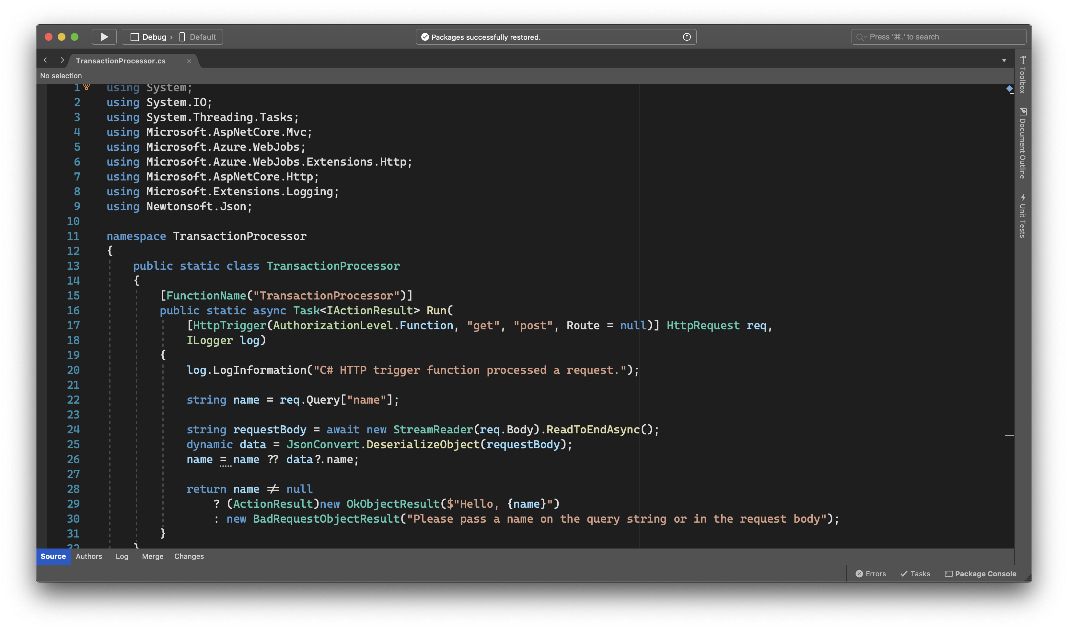
Next generation cloud development
Create powerful micro-services with Docker
Create portable solutions with one-click containerization
Built-in support for Docker from the get-go
Full support for local development
Deploy containerized apps directly to Azure App Service
Serverless solutions at your fingertips
Develop cloud-native solutions for Azure
Iterate quickly with simple deployment wizards
Build and run Azure Functions locally
Debug Azure Functions locally with live events

Slide 25

.NET Core 3.1
Long-Term Support (LTS)
WPF and Windows Forms support
Side-by-side support & self-contained EXEs
Full-stack web development with C# and Razor
New C# 8.0 language features
dot.net/get-core3
Notes:
We’ve added Windows Desktop support with Windows Forms and WPF support. This brings the capabilities of .NET Core to these UI frameworks which millions of .NET developers are building on today. Particularly useful is the flexible deployment with side-by-side and self-contained EXEs so you don’t have to have .NET installed on the machine first anymore.
We also have some exiting new things for Web developers with Blazor, adding full-stack web development with C# and Razor, allowing you to build beautiful and responsive Single Page Apps without having to write JavaScript!
Additionally we have a ton of improvements for building better cloud native, scalable apps and microservices with ASP.NET and of course some exciting C# 8.0 language features.
<CLICK>

Slide 26
Microservices
Notes:
Today we’re going to show you how .NET can be used to build any type of app. We’re going to start with cloud development and microservices.
<CLICK TO NEXT SLIDE>

Slide 27
Microservices: for faster app development
Monolithic
Microservices
Large, all-inclusive app
Small, independent services
Independent deployments
Improved scale and resource utilization per service
Smaller, focused teams
App
App
App
Notes:
Briefly explain the software trend to microservices for faster app development
With the move to the cloud over the last few years, the industry has embraced an architectural pattern for building cloud-scale, reliable services.
Microservices are Independent, immutable deployments within containers
Small scalable services for improved resource utilization
Teams can focus on their own service without affecting other, use their own tools/stack
.NET Core was built for the cloud and is well suited for this type of development

Slide 28
Azure Kubernetes Service (AKS)
Ship faster, operate easily, and scale confidently with managed Kubernetes on Azure
Manage Kubernetes with ease
Accelerate containerized development
Build on an enterprise-grade, secure foundation
Run anything, anywhere
Notes:
There are many orchestrators you can use to reliably run your microservices. Orchestrators make sure your services are communicating, scaling and performing well -- Kubernetes is one of the most popular. With Azure Kubernetes service you can manage Kubernetes easily.
You don’t need to worry about setting up secure communication of your services
AKS automatically takes care of monitoring, scaling and managing all your containers
<CLICK>

Slide 29
ASP.NET Core 3
www.asp.net
gRPC
High performance contract-based RPC services with .NET
Works across many languages and platforms
Worker Service
Starting point for long running back processes like Windows Server or Linux daemon
Producing or consuming messages from a message queue
Web API’s + Identity
Add security and authentication to Web API’s
Notes:
We’ve added a ton of features to ASP.NET Core in version 3.0 on order to make building resilient microservices easier.

Slide 30
.NET Core 3 Microservices
DEMO
Notes:
And to show you just what I mean, I’d like to invite Glenn Condron up on stage.

Slide 31
C#
Notes:
Thanks Glenn!
Now let’s talk about C#.
<CLICK>

Slide 32
C# 8.0
Safe
Nullable and non-nullable reference types help you write safer code
Declare your intent more clearly
Modern
Async streams for modern workloads like cloud & IoT communication
Easily work with cloud scale datasets using indexes and ranges
Productive
Write less code using patterns
Protect data with readonly members
Improved using statements for resource management
Notes:
Most features of C# 8.0 capture a common action with new syntax, avoiding the bugs that come from having to write and maintain the longer version you would have had before.
C# 8.0 embraces modern development because the operations that get new syntax are ones with emerging importance in the modern developer landscape, like working with cloud scale datasets and asynchronous communication.
<CLICK>

Slide 33
C# 8.0
DEMO
Notes:
I’d like to invite Mads up on stage to show off C# 8.0.

Slide 34
Mobile apps with Xamarin
Notes:
Thanks Olia!
Next, we have some exciting new features in Xamain for building mobile apps.
<CLICK>

Slide 35

Xamarin
www.xamarin.com
iOS & Android with C#
Native performance, native APIs, native UI
Build native mobile apps with Visual Studio
Cross-Platform
Build cross-platform UIs with Xamarin.Forms
Access native APIs from shared code with Xamarin.Essentials
Share code with .NET Standard
Free & Open Source
Xamarin is part of .NET and open source on GitHub

Slide 36
Xamarin
DEMO
Notes:
I’d like to invite James onto the stage to show off some of these awesome new features.

Slide 37
Web apps with Blazor

Slide 38
ASP.NET Core 3 Blazor
www.blazor.net
Full stack web development with C#
You don’t need to know AngularJS, React, Vue, etc.
Take advantage of stability and consistency of .NET
Runs in all browsers
Strongly typed on the client and server
Share C# code with the client and server
Web Assembly (In Preview, Release in May 2020)
Native performance
Requires no plugin or code transpilation
Notes:
Blazor is a new client-side web UI framework based on .NET and C# instead of JavaScript.
.NET has always had great support for building server-rendered web apps with ASP.NET, where your .NET code runs on the server and generates HTML & JSON responses. But if you ever wanted to add some client-side functionality to your web app that runs in the browser on the user's device, that meant you had to write some JavaScript.
Well, not anymore! Blazor enables full-stack web development with .NET using only open web standards. .NET Core 3.0 ships support for Blazor Server apps, which enables you to handle client-side UI interactions over a real-time SignalR connection. And in the near future with Blazor WebAssembly you'll be able to run your .NET code directly in the browser on WebAssembly-based .NET runtime.

Slide 39
Blazor
DEMO

Slide 40
Machine Learning

Slide 41
ML.NET
www.dot.net/ml
Built for .NET developers
Create custom ML models using C# or F# without having to leave the .NET ecosystem
Custom ML made easy with AutoML
Visual Studio Model Builder and CLI make it super easy to build custom ML Models
Extended with TensorFlow & more
Leverage other popular ML frameworks (TensorFlow, ONNX, and more)
Notes:
Support for new scenarios such as Sales Forecasting, Anomaly Detection
General availability of TensorFlow and ONNX support
Preview: Native database loader that enables training directly against relational databases
Preview: Build custom deep learning models using Tensorflow
Support .NET Core 3 - New scenarios in Model Builder - GitHub Issue classification
"and we're working on adding some cool stuff, which we'll show you an example of in the next demo" .. or something like that (because deep learning for Model Builder won't be released for a while)

Slide 42
RELEASED
ML.NET 1.4
Adds image classification training
Relational database loader for training models
Visual Studio Model Builder extension released
aka.ms/mlnet41
Notes:
ML.NET 1.4 GA release adds image classification training with the ML.NET API as well as a relational database loader API for reading data used for training models with ML.NET. In addition, a new preview of the Visual Studio Model Builder extension is available which also supports image classification training all from a graphical UI. Finally, we're releasing a preview of Jupyter support for writing C# & F# code for ML.NET scenarios.

Slide 43
ML.NET
DEMO

Slide 44
Agenda
Timing | Session | Speakers
9:50 AM | Building Blazor applications on a Mac | Dan Roth Kendra Havens
10:30 AM | Realtime web applications, from your Mac to the Cloud, with SignalR and Azure | Brady Gaster
11:10 AM | Working with ASP.NET Core on macOS | Sayed Ibrahim Hashimi Jon Galloway
11:50 AM | Serverless apps with .NET Core and macOS | Jeff Hollan
12:30 AM | What's new for Unity developers on macOS | Abdullah Hamed Sarah Sexton
1:10 PM | Building mobile applications with .NET Xamarin | Maddy Leger James Montemagno
1:50 PM | How to be productive developing with .NET on a Mac | Mikayla Hutchinson Kendra Havens
2:30 PM | Closing and Virtual Attendee Party Closing session | Jeff Fritz Jon Galloway

Slide 45
What Next?
Download Visual Studio for Mac
https://aka.ms/vs/mac/download
Check our Visual Studio for Mac 101 videos
https://aka.ms/vsmac-101
Start building Xamarin and .NET Core applications
https://dotnet.microsoft.com/learn/

